Slide 1
MIS 637: Data Analytics and Machine Learning
Data Science
Data Analytics and Machine Learning
M. Daneshmand, PhD
Ptofessor, Stevens Instutute of Technology
January 10, 2019

Slide 2
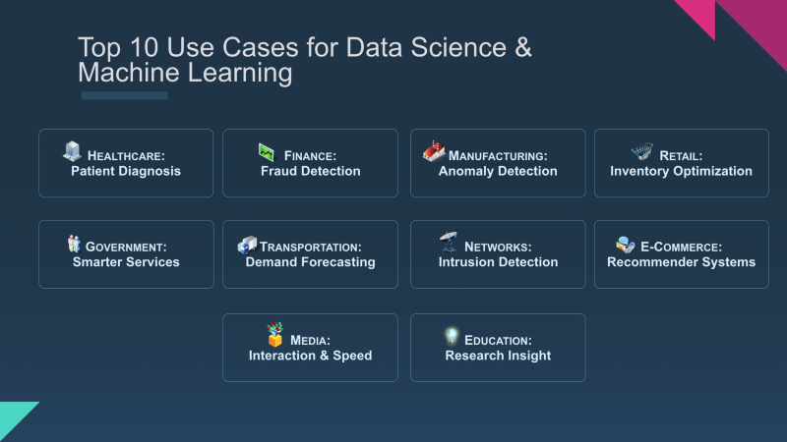
January 10, 2019

Slide 3
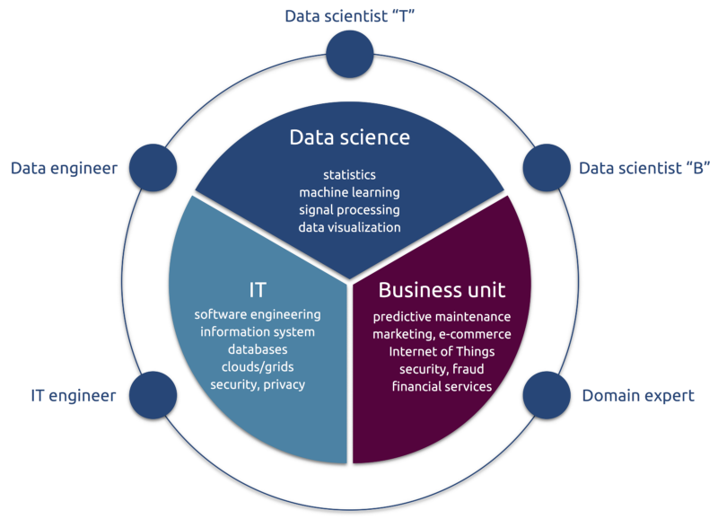
Data Science Definition
January 10, 2019

Slide 4
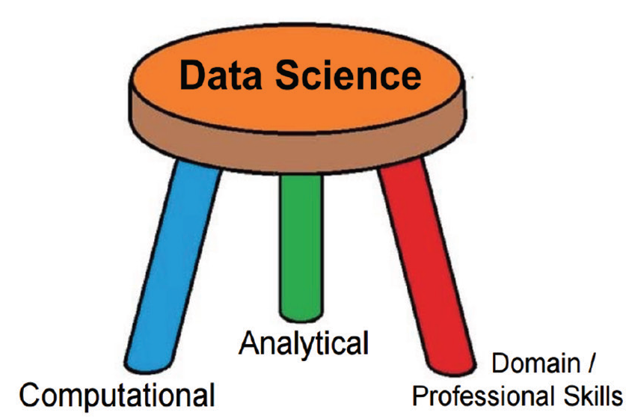
Data Science Definition
January 10, 2019

Slide 5
Analytics
January 10, 2019

Slide 6
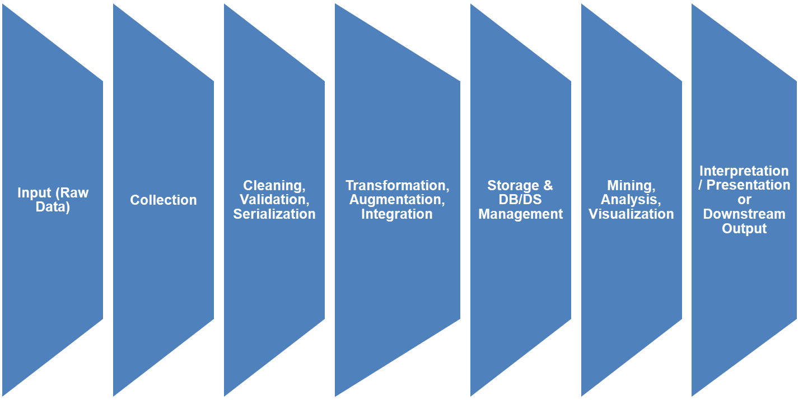
Data Lifecycle I (Basic)
Can we completely automate the staging of data for analysis (From origination to analysis ready)?
January 10, 2019

Slide 7
End-to-End Data Analytics: An Application
Input
(Raw
Data)
Cleaning,
Validation &
Serialization
Transformation
&
Augmentation
Storage &
DB
Management
Mining &
Analysis
Interpretation &
Presentation
Output
Collection
Power
Wall
Learning
and
New Questions
Pzip’d
Call
Detail
SWIFT
InfoLab
Databases
Analysts
Collector
Billing
Global
Fraud
Mgmt
System
Cases
Strategic
Decision-
Making
450
Switches
Collector
Fixed-format
Call Records
Fraud
Case
Managers
Vetter
Streamer
Alerts
Collector
AMA
Processor
Signatures
Hancock
Reports
Operationalization:
-Procedural
-Automated
Collector
Call
Detail
SCAMP
COI
Analysis
Analysts
AMA Data
from switches
-350M calls/day
-60 Gb data/day
-150 bytes/record
COI
Displays
Data
Barn
2 minutes
Further Investigation
(Queries)
January 10, 2019

Slide 8
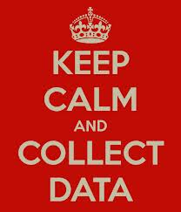
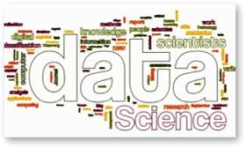
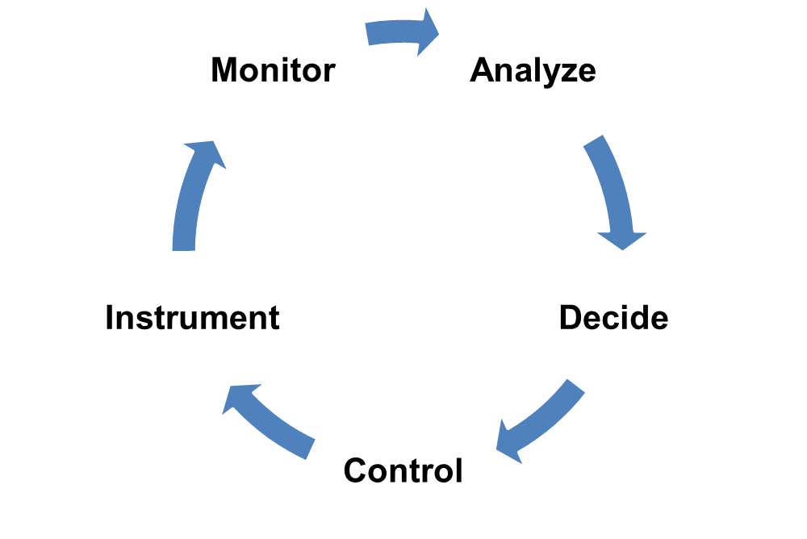
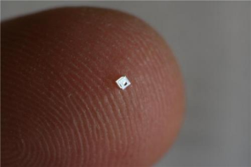
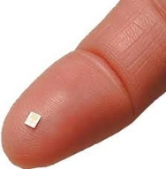
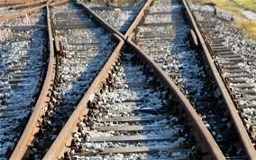
Data Analysis Lifecycle: For Machines
Internet of Things
Big Data
January 10, 2019

Slide 9

Challenges of Data Analytics
Stream Analytics
Sensor Analytics
Real-Time Analytics
Big Data Analytics
Machine Learning Analytics
Mathematical/Statistical Analytics
January 10, 2019
Notes:
Reference*
http://www.ibmbigdatahub.com/blog/big-data-analytics-will-permeate-internet-things

Slide 10
Analytics
Big Data Research and Development Initiative
Mathematics for Analysis of Petascale Data addresses the mathematical challenges of extracting insight from huge
scientific datasets, finding key features and understanding the relationships between those features. Research areas include machine learning, real time analysis of streaming data, stochastic nonlinear data - reduction techniques and scalable statistical analysis techniques applicable to a broad range of DOE applications including sensor data from the electric grid, cosmology and climate data.
January 10, 2019

Slide 11
Discovery with Data:
Leveraging Statistics with Computer
Science to Transform Science and Society
The most productive approach for turning data into knowledge will involve multidisciplinary
teams with statistical, computational, mathematical, and scientific domain expertise
ASA Team from: MIT, Duke, Harvard, CMU, NCSU, Hopkins, Berkeley, PSU, U Washington
July 2, 2014,
January 10, 2019

